Slide 1
ESC-DPA Coverage Methodology
11-15-2018

Slide 2
Irregular Terrain Model P2P Parameters
Dielectric Constant: 81
Conductivity: 5.0
Surface Refractivity: 350
Frequency: 3600 MHz
Radio Climate: Maritime Temperate over Sea (7)
Mode of Variability: 12
Confidence: 50%
Polarization: Vertical
Radar Transmission Height: 50m

Slide 3
Input Parameters
210 dB used as the path loss threshold
Radar EIRP (121 dBm/MHz) – ESC detection threshold (-89 dBm/MHz)
E-DPA.kml
For locations inside the DPA and less than 75 km from the shore, use 95% Reliability to calculate path loss.
75km kml files provided by NTIA
For locations inside the DPA and greater than 75 km from the shore, use 50% Reliability to calculate path loss
Example DPA grid spacing
Points spaced 1km along the DPA edge and a 1km x 1km grid

Slide 4
ESC Input Parameters
Sensor Name
Latitude (decimal degrees)
Longitude (decimal degrees)
Antenna Height (AGL) (meters)
Antenna Gain (dBi)
Cable Loss (dB)
Antenna Horizontal Beam width (degrees)
Antenna Vertical Beam width (degrees)
Antenna Azimuth (0° is North)
Antenna Downtilt
ESC-DPA Coverage Combinations

Slide 5
ESC-DPA Coverage Combinations (Logic)
Calculate the ESC-DPA coverage for each set of ESCs.
For Example:
For each row, all ESC Sensor(s) need to be online.
A detection by any one of the sensor(s) activates the DPA.
DPA Name | Sensor Name
East DPA 1 | Sensor #001
East DPA 1 | Sensor #002 | Sensor #003
East DPA 1 | Sensor #004 | Sensor #005 | Sensor #006

Slide 6
Example Calculations
DPA Name | Sensor Name
East DPA 1 | Sensor001 | Sensor002
East DPA 1 | Sensor001 | Sensor003
Site Name | Latitude | Longitude | ESC Antenna Height | ESC Antenna Azimuth | ESC Antenna Downtilt | Horizontal Antenna Beamwidth | Horizontal Antenna Beamwidth | Antenna Gain
Sensor001 | 36.38 | -75.98 | 20 | 90 | 0 | 120 | 60 | 5
Sensor002 | 37.94 | -75.54 | 20 | 120 | 0 | 120 | 60 | 5
Sensor003 | 37.18 | -75.96 | 20 | 90 | 0 | 120 | 60 | 5

Slide 7
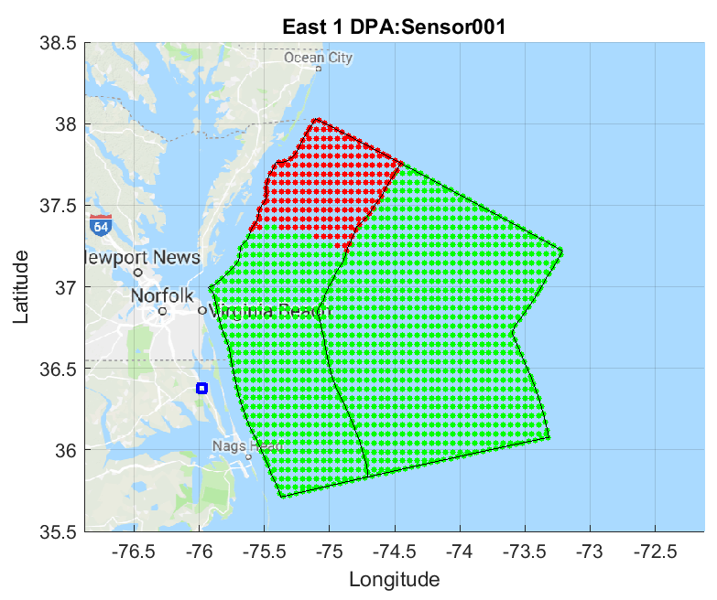
Single Sensor DPA Coverage
75km
DPA
95%
Reliability
50%
Reliability
ESC

Slide 8
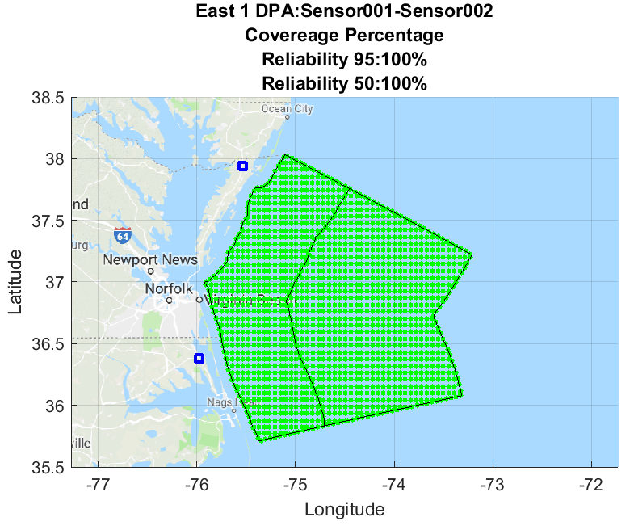
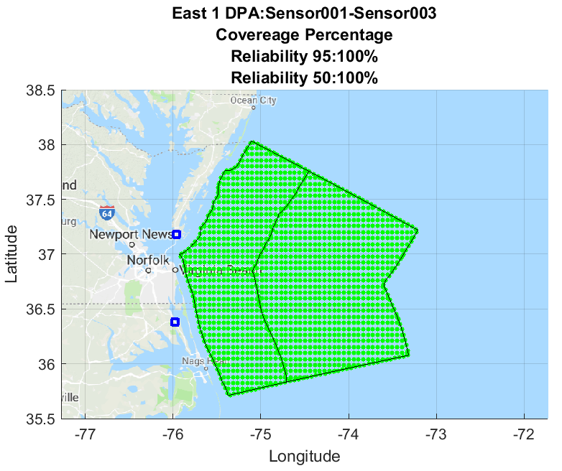
Combination DPA Coverage
DPA Name | Sensor Name
East DPA 1 | Sensor001 | Sensor002
East DPA 1 | Sensor001 | Sensor003

